Slide 1
Cryo PLC issues [May 2011]: CASES
(1) [11/5/2011] Crash PLC QUI P4 (Occurred during the Last Tech. Stop)
Known problem using UNITY in the terminal server: Two developers worked concurrently with the development tool.
(2) [13/5/2011] Crash QSCB P8
PLC was just rebooted and no replaced. (Agreed with the cryo operation)
Dump sent to Schneider. After their analysis it seems that an electronic component called RAM Tag provoked a bad usage of the Cache memory which got corrupted.
(3) [25/5/2011] Crash QURCB P8 (US85)
Possible SEU already under study! (happened before: [19/04/2011])
PLC replaced again. Dump in Schneider hands to perform the analysis.
(4) [25/5/2011] Crash QSCB P8
PLC replaced and dump sent to Schneider
Confirmation of the previous mentioned problem with the component RAM Tag

Slide 2
Cryo PLC issues [May 2011]: SUMMARY
Human mistake
Bad procedure applied during a TS (short time and many actions)
Reinforced procedural mechanisms
Abandon of the Windows Terminal Servers solution
SEU
Already two occurrences for the same location but different PLCs (within one month)
A possible third case in 10/2010: QURA located also in the US85.
Mitigation plan needed!
Schneider PLC Crash
Confirmation of a bad component (same PLC: occurred twice)
Within MTBF of the Cryo control system (~ 1 failure per year for 65 PLCs)
Waiting Schneider full analysis for a adequate action(e.g.: bad series or just one-time event)

Slide 3
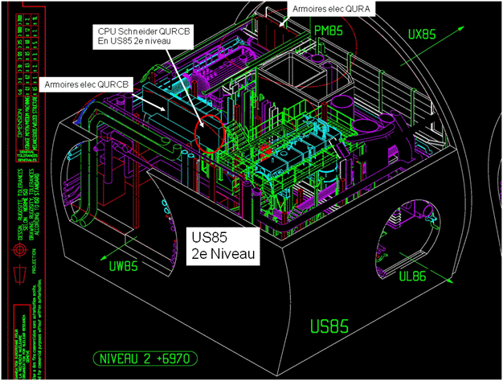
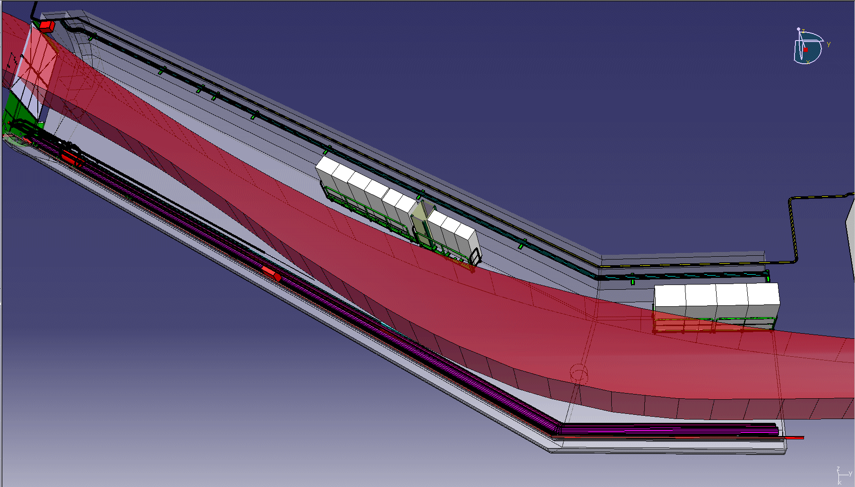
Cryo PLC issues [May 2011]: SEU
Moving equipments to a safer place: UL84 (already foreseen in Ph3 works)
Phase 1,2: UX85 to the UL84 (done)
Phase 3: US85 to the UL84 (2011/2012)
Intermediate solution: moving only the PLC CPU.
Technical feasibility already studied and approved.
Scheduled for the next Technical Stop if the needed equipment reaches CERN on time (already ordered but delivery may take up to 6 weeks)
Relocation Racks
CB 2011/2012
After relocation
UL84
Rack avec
Espace dispo
Pour CPU QURCB

Slide 4
Cryo PLC issues [May 2011]: PLC Crash
Possible scenarios
No action: MTBF accepted as normal behavior (not an improvement !)
Schneider identifies again a series of PLCs where the faulty component is potentially a problem: A second campaign of PLC replacement could take place.
Reengineering of the solution: Redundancy solution (certainly increases the availability!)
An hypothetical redundant solution: (~ 65 PLCs)
CPU family change (Premium to Quantum)
Cabling: replace Premium I/O cards by a decentralized Profibus stations
Porting logic code to the new platform (expected light changes in the current code)
I/O mapping reconfiguration
Cost: First estimation of about 1.5 MCHF on material and 2MY for the cabling and control code activities
Other study includes migration to other platform but the cost may have to be taken into account because the needed migration of more than 17.000 A4 graphical code (large regression risk!)

